Slide 1
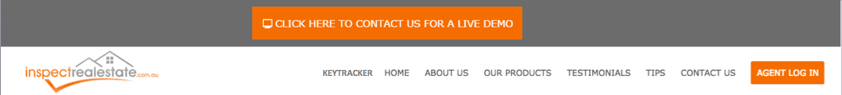
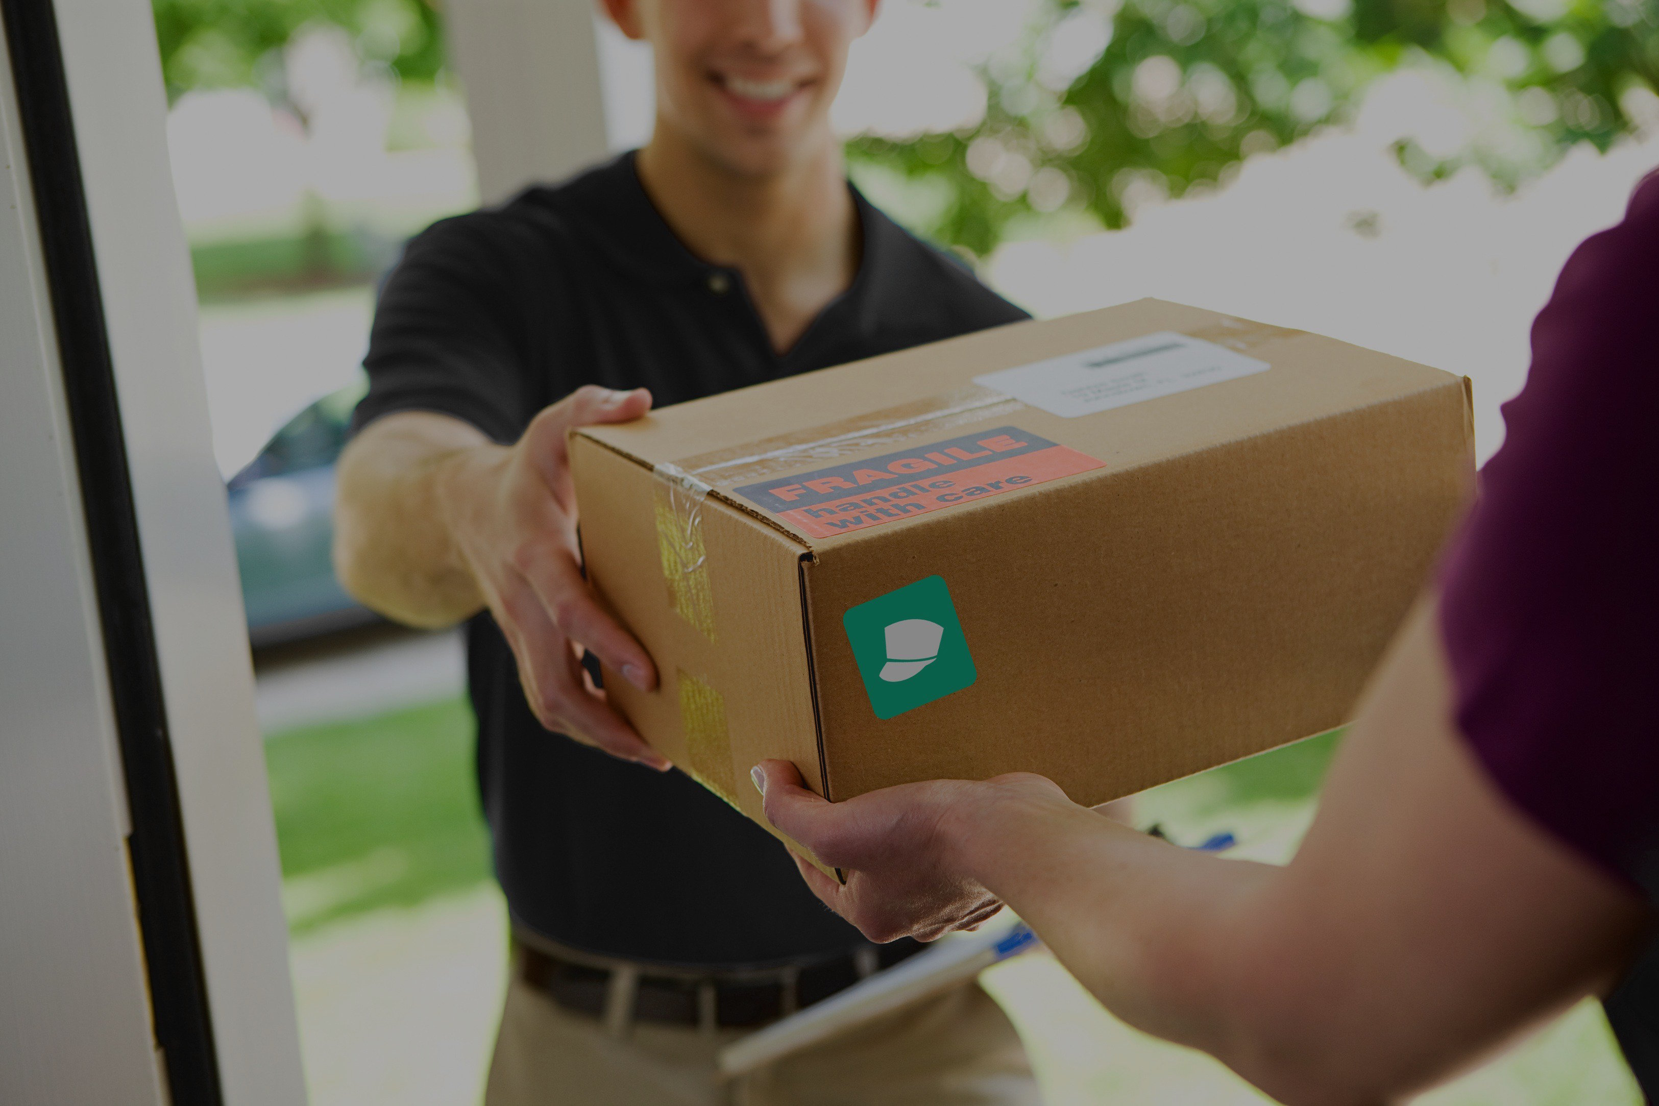
On the Spot Courier
Get your package there
START ORDERING
HOW IT WORKS
Need a hand with your package?
We offer fast, efficient and affordable package delivery solutions

Slide 2




Need a hand with your package?
We offer fast, efficient and affordable package delivery solutions
FEATURES
PRICING
SUPPORT
TESTIMONIALS
FAQ
Click one of above to learn more

Slide 3
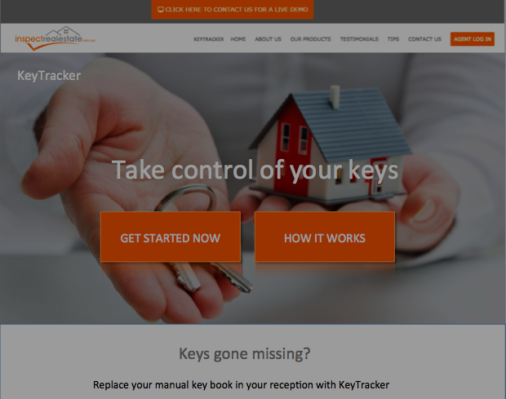

Notes:
How it works video

Slide 4
EXISTING CUSTOMER
:
NEW CUSTOMER
:
CREATE ACCOUNT
SIGN IN
CONTINUE WITHOUT ACCOUNT
CREATE NEW ORDER
CONTINUE

Slide 5

WHAT WOULD YOU LIKE TO ORDER?
DANGEROUS GOODS
SMALL PACKAGES
LARGE PACKAGES
EXCESS BAGGAGE
WHERE WOULD YOU LIKE TO SEND IT?
LOCALLY
INTER-STATE
INTER-NATIONALLY
CONTINUE

Slide 6

ORDER DETAILS
Name:
Phone Number:
Email:
Billing Address:
Post Code
Street Number
Street Name
Unit Number
City
CONTINUE

Slide 7
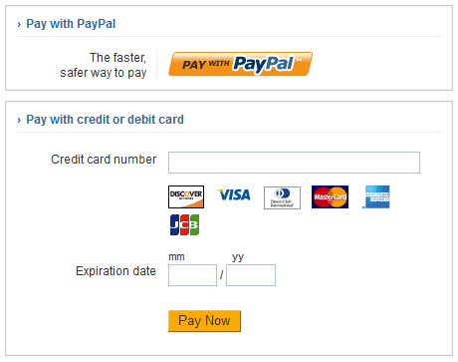
Please Enter in your Payment Details

Slide 8

Congratulations you have completed your order!
Thank you for your order!
A digital receipt has been sent to your email
GO HOME

